Slide 1
Blood Bank Management System Brij Mohan Rauniyar Employee id-173569

Slide 2
Table of contents:
Introduction
Technology and Software Used
Work flow
Architecture Diagram
Homepage
Admin Login Page
User Registration page
Patient Registration page
Admin page
Database Table

Slide 3
Introduction:
Blood Bank Management System maintain considerable information of the Patients, Donors, report details for any blood-related organization.
Donor can register to donate blood. All the information will store in database.
Admin can login to add patient information, and can view the available blood groups in blood bank table.
Admin can view total quantity of particular blood group.
Patient Blood group match with user blood group then notification will send to user.

Slide 4
Technology and Software used:
Angular 6 for frontend - VS Code
Spring boot 3 for middle ware - Spring Suite
MySQL for backend- MySQL Server

Slide 5
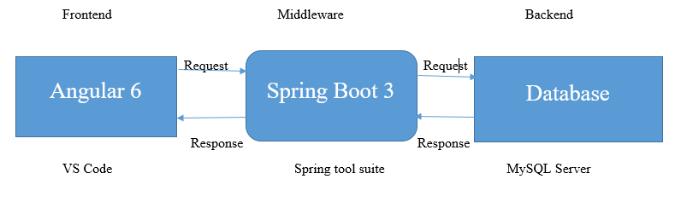
Workflow
Architectural diagram

Slide 6
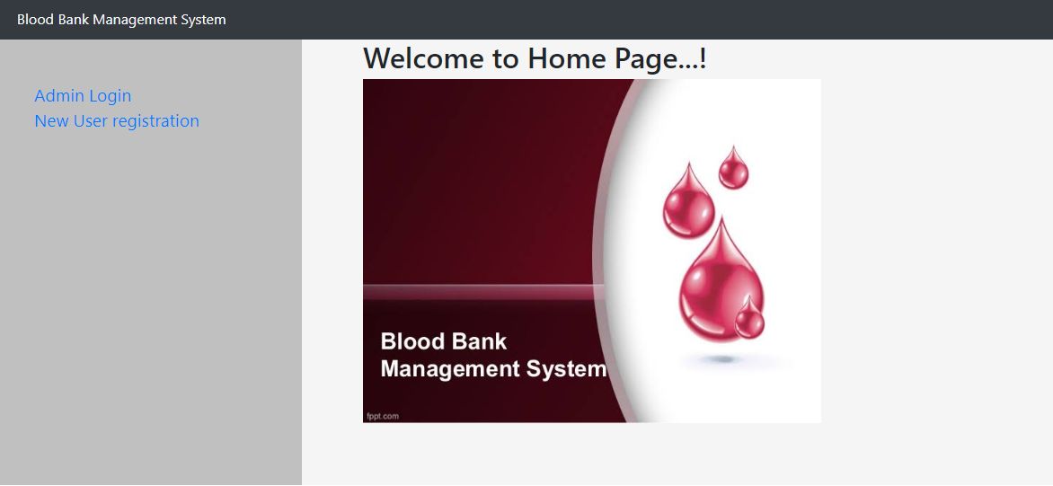
Home Page

Slide 7
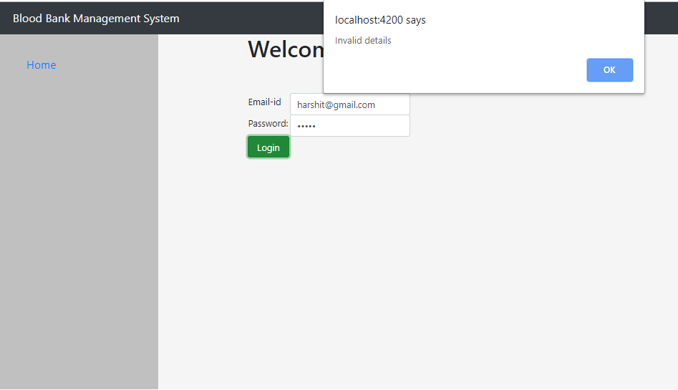
Admin login Page
Admin cannot login with invalid credential.

Slide 8
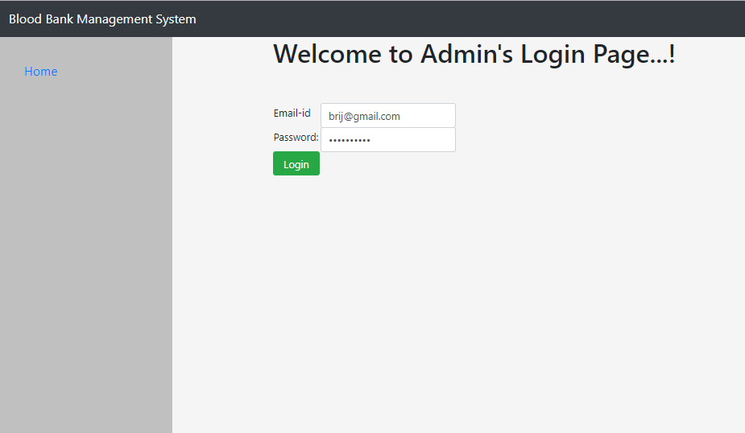
When Admin enters the correct credentials, the page is redirected to Admin page.

Slide 9
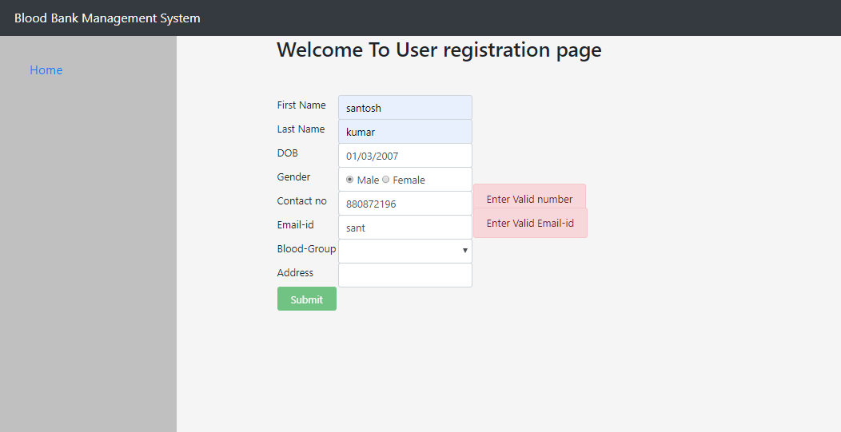
User Registration Page
Only valid User format allowed.

Slide 10
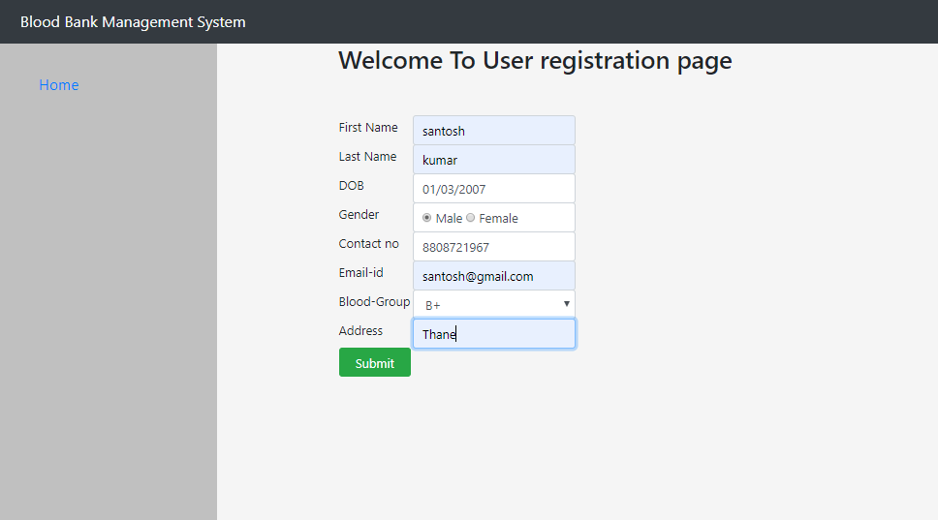
After user registration, user details will show on admin page.

Slide 11
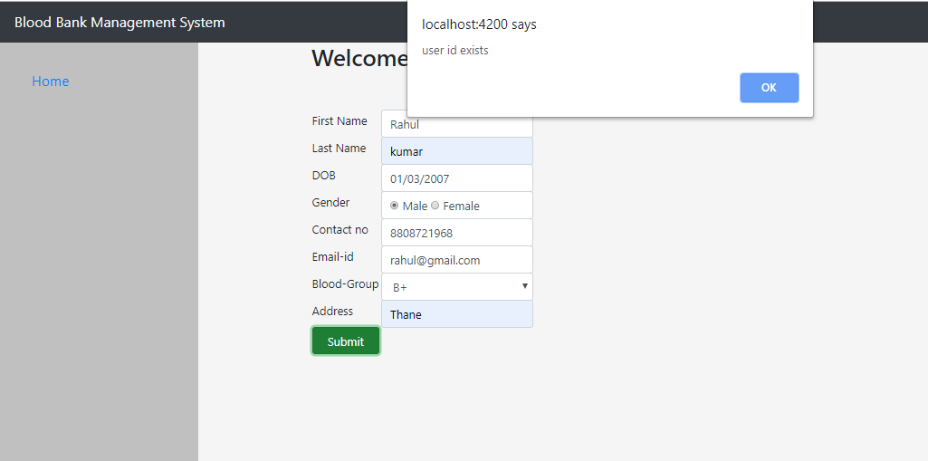
If the user email id already exists in database, the user will not be added

Slide 12
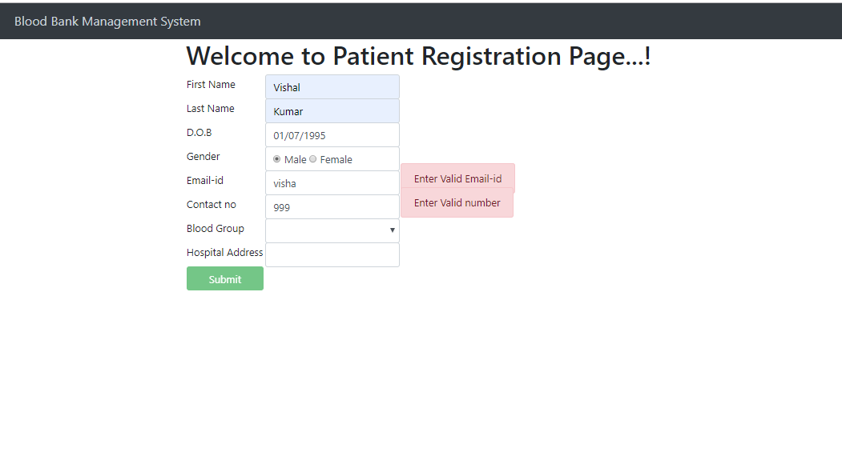
Patient Registration Page
Admin cannot add patient in invalid format.

Slide 13
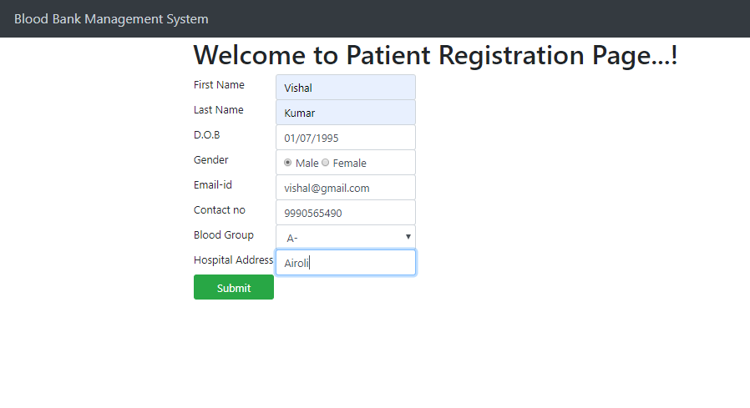
After patient registered, it will be shown on admin page.

Slide 14
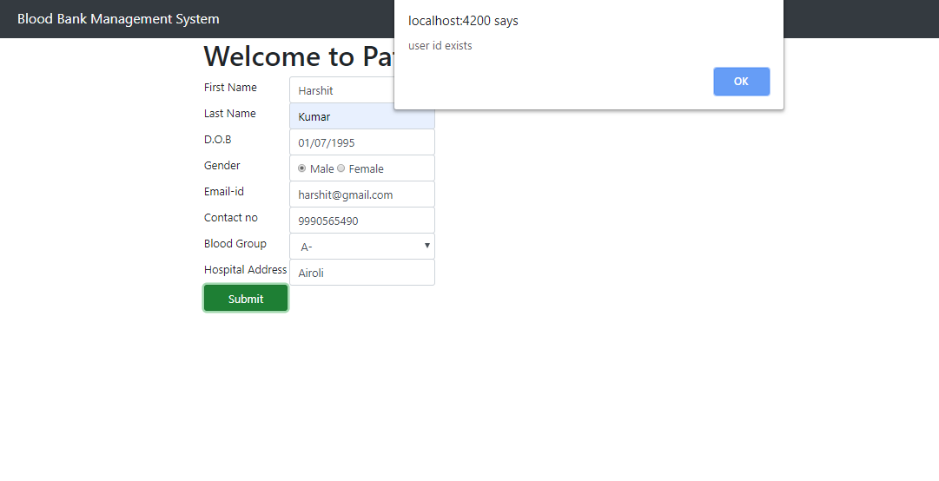

Slide 15
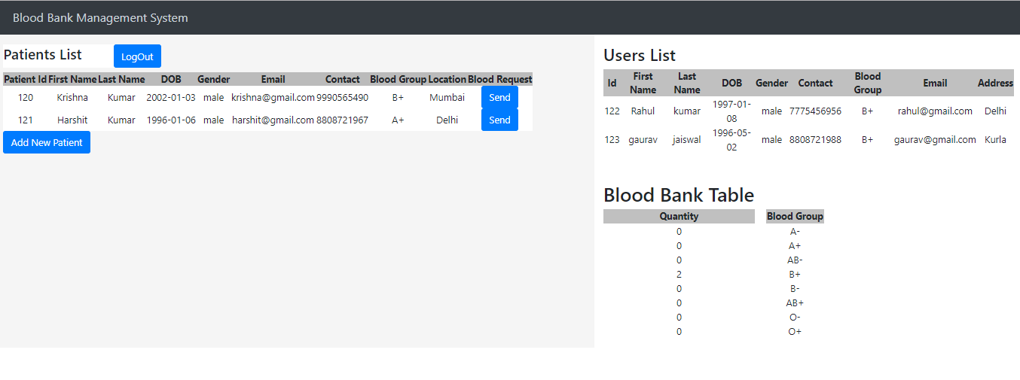
Admin Page
This page contains patient list, user list and Blood bank table.

Slide 16
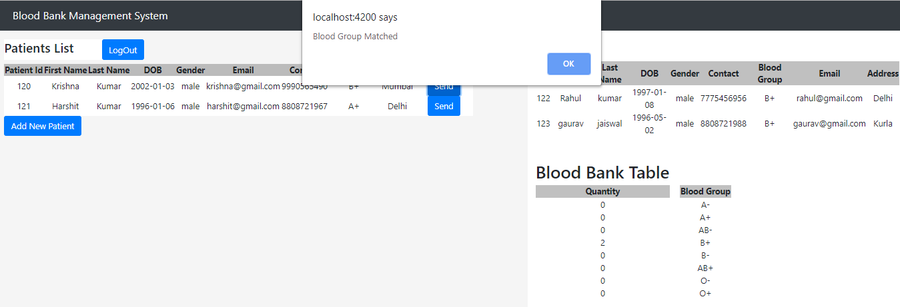
Blood Match
If patient blood group match with user list , Then show the message blood group matched.

Slide 17
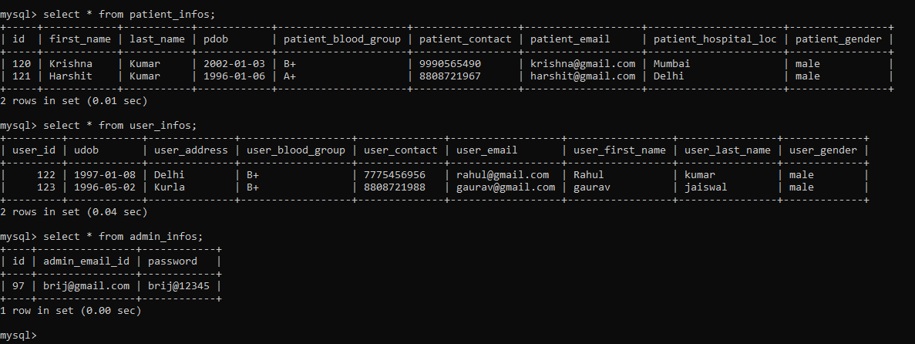
Database table

Slide 18
Thank You

